Slide 1
FASTER POSTINGS MERGES:
SKIP POINTERS/SKIP LISTS

Slide 2
Recall basic merge
Sec. 2.3
Walk through the two postings simultaneously, in time linear in the total number of postings entries
2
4
8
41
48
64
128
Brutus
2
8
1
2
3
8
11
17
21
31
Caesar
If the list lengths are m and n, the merge takes O(m+n)
operations.
Can we do better?
Yes (if index isn’t changing too fast).

Slide 3
Augment postings with skip pointers (at indexing time)
Sec. 2.3
41
128
2
4
8
41
48
64
128
11
31
1
2
3
8
11
17
21
31
Why?
To skip postings that will not figure in the search results.
How?
Where do we place skip pointers?

Slide 4
Query processing with skip pointers
Sec. 2.3
41
128
2
4
8
41
48
64
128
11
31
1
2
3
8
11
17
21
31
Suppose we’ve stepped through the lists until we process 8 on each list. We match it and advance.
We then have 41 and 11 on the lower. 11 is smaller.
But the skip successor of 11 on the lower list is 31, so
we can skip ahead past the intervening postings.

Slide 5
Where do we place skips?
Sec. 2.3
Tradeoff:
  More skips → shorter skip spans ⇒ more likely to skip. But lots of comparisons to skip pointers.
  Fewer skips → few pointer comparison, but then long skip spans ⇒ few successful skips.

Slide 6
Placing skips
Sec. 2.3
Simple heuristic: for postings of length L, use √L evenly-spaced skip pointers.
This ignores the distribution of query terms.
Easy if the index is relatively static; harder if L keeps changing because of updates.

Slide 7
Why are skip pointers not useful for queries of the
form x OR y?

Slide 8
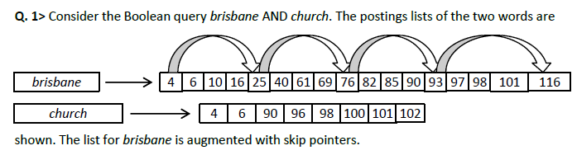
How many comparisons are required in the situation
shown, when brisbane has skips? List the comparisons
sequentially.
How often is a skip pointer used in the above situation?

Slide 9
Comparisons: <4, 4>; <25, 6> (Skip? Check – Fail);
<6, 6>; <10, 90>; <16, 90>; <25, 90>; <76, 90>
(Skip? Check – Success); <93, 90> (Skip? Check – Fail);
<82, 90>; <85, 90>; <90, 90>; <93, 96>; <116, 96>
(Skip? Check – Fail); <97, 96>; <97, 98>; <98, 98>;
<101, 100>; <101, 101>; <116, 102>
Once [25 -> 76]

Slide 10

Consider the following postings list augmented with skip
pointers at a uniform skip size of 4
At some stage in processing an AND query, we need to
merge the entries in this postings list with the entries
in the candidate list (3,5,89,95,97,99,100,101).
We define the following four operations:
Compare(A,B): compare entry A in postings list with entry B in the
candidate list
Output(X): output value X as a result of the merge process
LookAheadTo(X): peek ahead to take a look at the target X of a
skip pointer
SkipTo(X): follow a skip pointer to reach entry X

Slide 11
In performing this merge, list the instances of
Output, LookAheadTo, and SkipTo operations in the
order in which they would be executed.
(Note: Do not list instances of Compare).
You need to follow the rule that the last look ahead
value is discarded. At skip points, lookahead before
operating on the current postings entry
List the Compare operations would be executed

Slide 12
LookAheadTo(24)
Output(3)
Output(5)
LookAheadTo(75)
SkipTo(75)
LookAheadTo(92)
Output(89)
LookAheadTo(115)
Output(97)
Output(100)
there are 19 compares:
3) (3 3) (5 5) (9 89) (15 89) (24 89) (75 89) (92 89)
(81 89) (84 89) (89 89) (115 95) (92 95) (96 95) (96 97)
(97 97) (100 99) (100 100) (115 101)

Slide 13
PHRASE QUERIES AND POSITIONAL INDEXES

Slide 14
Phrase queries
Sec. 2.4
Want to be able to answer queries such as “stanford university” – as a phrase
Thus the sentence “I went to university at Stanford” is not a match.
The sentence “The inventor Stanford Ovshinsky never went to university” is not a match.
  The concept of phrase queries has proven easily understood by users; one of the few “advanced search” ideas that works
  Many more queries are implicit phrase queries
For this, it no longer suffices to store only
<term : docs> entries

Slide 15
A first attempt: Biword indexes
Sec. 2.4.1
Index every consecutive pair of terms in the text as a phrase
For example the text “Friends, Romans, Countrymen” would generate the biwords
  friends romans
  romans countrymen
Each of these biwords is now a dictionary term
Two-word phrase query-processing is now immediate.

Slide 16
Longer phrase queries
Sec. 2.4.1
:
stanford university palo alto can be broken into the Boolean query on biwords:
stanford university AND university palo AND palo alto
Without the docs, we cannot verify that the docs matching the above Boolean query do contain the phrase.
Can have false positives!

Slide 17
Issues for biword indexes
Sec. 2.4.1
False positives, as noted before
Index blowup due to bigger dictionary
  Infeasible for more biwords
Biword indexes are not the standard solution (for all biwords) but can be part of a compound strategy

Slide 18
Solution 2: Positional indexes
Sec. 2.4.2
In the postings, store, for each term the position(s) in which tokens of it appear:
  <term, number of docs containing term;
  doc1: frequency of the term; position1, position2 … ;
  doc2: frequency of the term; position1, position2 … ;
  etc.>

Slide 19
Positional index example
Sec. 2.4.2
<be: 993427;
1: 6; 7, 18, 33, 72, 86, 231;
2: 2; 3, 149;
4: 5; 17, 191, 291, 430, 434;
5: 11; 363, 367, …>
Which of docs 1,2,4,5
could contain “to be
or not to be”?
For phrase queries, we use a merge algorithm recursively at the document level
But we now need to deal with more than just equality

Slide 20
Processing a phrase query
Sec. 2.4.2
Extract inverted index entries for each distinct term: to, be, or, not.
Merge their doc:position lists to enumerate all positions with “to be or not to be”.
  to:
    2: 5; 1,17,74,222,551; 4: 5; 8,16,190,429,433; 7: 3; 13,23,191; ...
  be:
    1: 2;17,19; 4: 5;17,191,291,430,434; 5: 3; 14,19,101; ...
Same general method for proximity searches

Slide 21
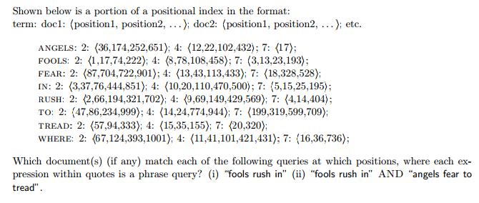

Slide 22
(i) doc2:1, doc4:8, doc7:3,13 (ii) doc4:8 & 12

Slide 23
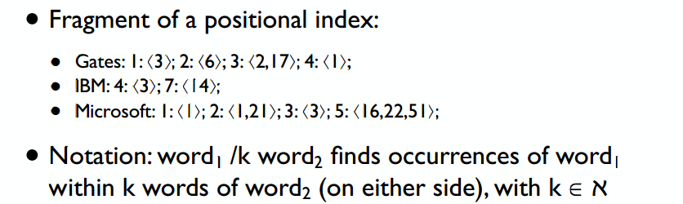
Describe the result for the query «Gates /1 Microsoft»:
Describe the result for the query «Gates /2 Microsoft»:

Slide 24
Describe the result for the query «Gates /1 Microsoft»:
: {k = 1} gives {3};
Describe the result for the query «Gates /2 Microsoft»:
: {k = 2} gives {1};

Slide 25
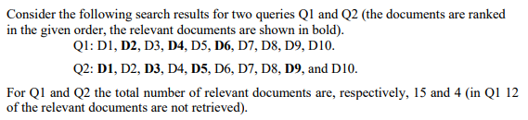

Slide 26
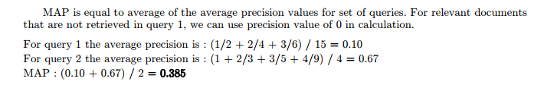

Slide 27
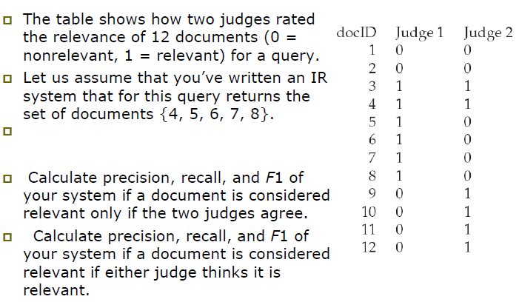

Slide 28
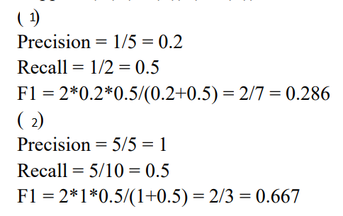

Slide 29
Assume a biword index. Give an example of a document which will be returned for a query of New York University but is actually a false positive which should not be returned.

Slide 30
New York City has Old York University Located in Manhattan

